Slide 1
Grammar Challenge
Correction commentée WORKSHEET 1
Mme Tanter, Lycée Ste Thérèse, 29000 QUIMPER, ac-rennes.

Slide 2
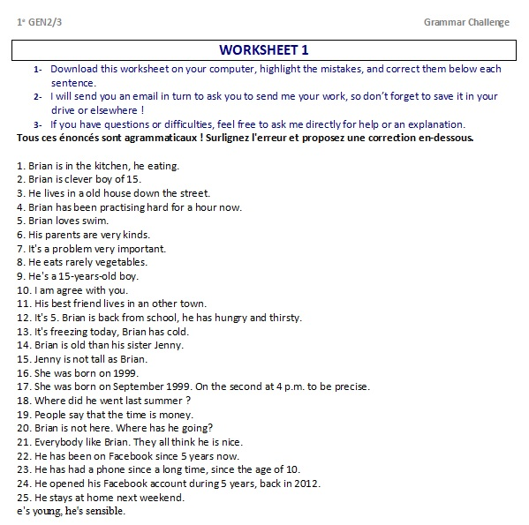

Slide 3
http://www.franglish.fr/

Slide 4
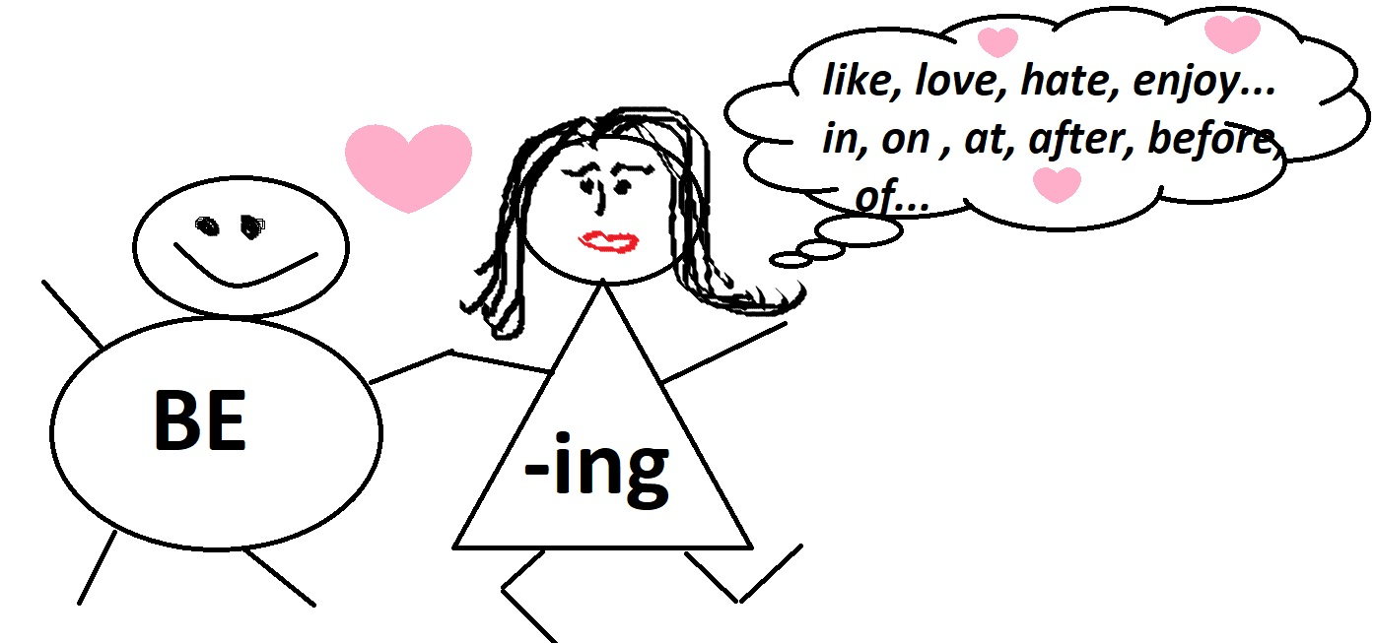
Brian is in the kitchen, he eating.
he IS eating
2. Brian is clever boy of 15.
B. is a clever boy of 15.
3. He lives in a old house down the street.
in an old house
4. Brian has been practising hard for a hour now.
for an hour
5. Brian loves swim.
B. loves swimming.
« BE se promène toujours avec –ING, sauf quand –ING traîne avec un verbe de goût ou une préposition »

Slide 5
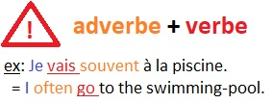
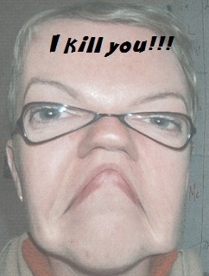
6. His parents are very kinds.
kind
7. It's a problem very important.
a very important problem
8. He eats rarely vegetables.
He rarely eats…
9. He's a 15-years-old boy.
a 15-year-old boy
10. I am agree with you.
I agree with you.

Slide 6
11. His best friend lives in an other town.
another
12. It's 5. Brian is back from school, he has hungry and thirsty.
he IS hungry and thirsty
13. It's freezing today, Brian has cold.
he IS cold.
14. Brian is old than his sister Jenny.
older than
15. Jenny is not tall as Brian.
not as tall as

Slide 7
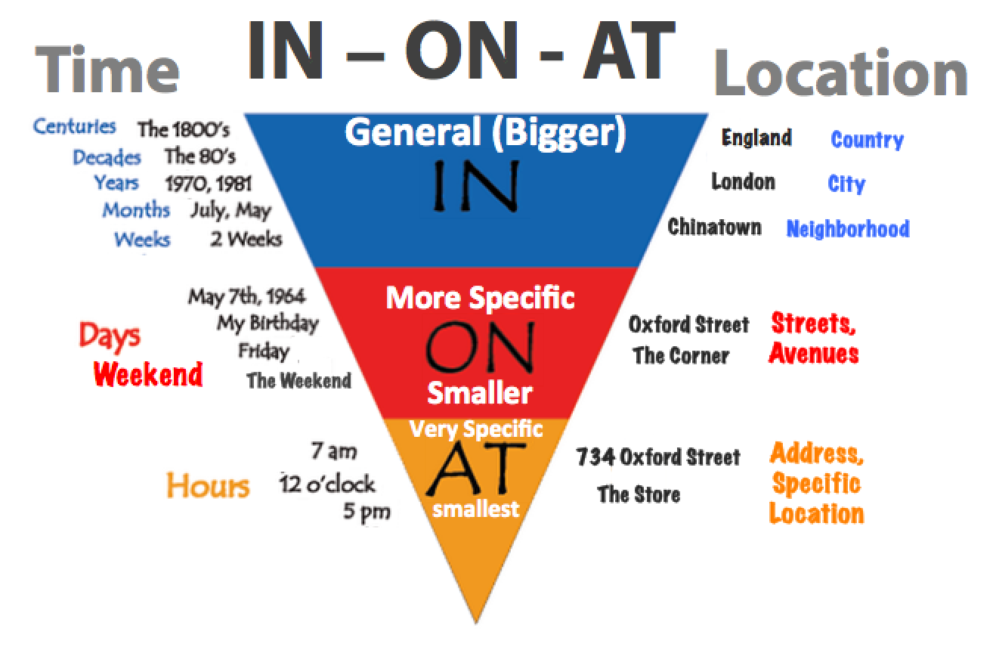
16. She was born on 1999.
in 1999
17. She was born on September 1999. On the second at 4 p.m. to be precise.
in September 1999.

Slide 8
16. She was born on 1999.
in 1999
17. She was born on September 1999. On the second at 4 p.m. to be precise.
in September 1999.
18. Where did he went last summer ?
did he go
19. People say that the time is money.
Ø time is money
20. Brian is not here. Where has he going?
Where has he gone? (to go, went, gone/been)

Slide 9
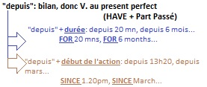
21. Everybody like Brian. They all think he is nice.
likes
22. He has been on Facebook since 5 years now.
for 5 years
23. He has had a phone since a long time, since the age of 10.
for a long time
24. He opened his Facebook account during 5 years, back in 2012.
5 years ago
25. He stays at home next weekend.
He is staying / he is going to stay/ he will stay

