Slide 1
GRAMMAR CHALLENGE
Correction WS3
Mme Tanter, Lycée Ste Thérèse, 29000 QUIMPER, ac-rennes.

Slide 2
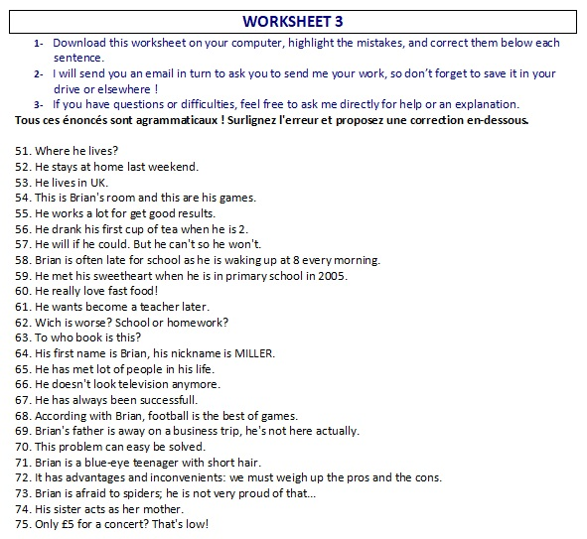

Slide 3
http://www.franglish.fr/

Slide 4
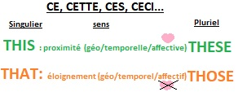
51. Where he lives?
does he live? (Q= MASVC?)
52. He stays at home last weekend.
stayed (or: He stays at home next WE)
53. He lives in UK.
the UK
54. This is Brian's room and this are his games.
these
55. He works a lot for get good results.
to get
56. He drank his first cup of tea when he is 2.
was

Slide 5
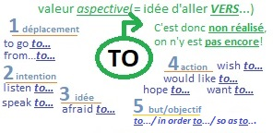
57. He will if he could. But he can't so he won’t.
would
58. Brian is often late for school as he is waking up at 8 every morning.
wakes
59. He met his sweetheart when he is in primary school in 2005.
was
60. He really love fast food!
loves
61. He wants become a teacher later.
to become

Slide 6
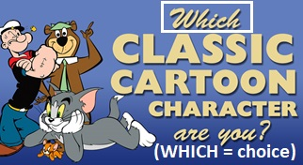
62. Wich is worse? School or homework?
Which
63. To who book is this?
Whose
64. His first name is Brian, his nickname is MILLER.
surname / family name
65. He has met lot of people in his life.
a lot of / Ø lots of
66. He doesn't look television anymore.
watch

Slide 7
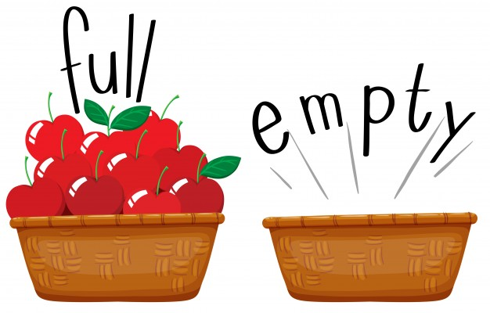
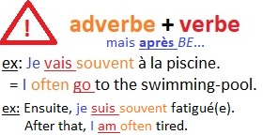
67. He has always been successfull.
successful
68. According with Brian, football is the best of games.
According to the best game ever.
69. Brian's father is away on a business trip, he's not here actually.
currently/presently
70. This problem can easy be solved.
can be easily solved
71. Brian is a blue-eye teenager with short hair.
blue-eyed (or: B is a blue-eyed, short-haired boy)

Slide 8
72. It has advantages and inconvenients: we must weigh up the pros and the cons.
drawbacks weigh the pros and cons
73. Brian is afraid to spiders; he is not very proud of that...
afraid of
74. His sister acts as her mother.
like his mother
75. Only £5 for a concert? That's low!
cheap!

Slide 9
