Slide 1
GRAMMAR CHALLENGE
Correction of WS 5
Mme Tanter, Lycée Ste Thérèse, 29000 QUIMPER, ac-rennes.

Slide 2
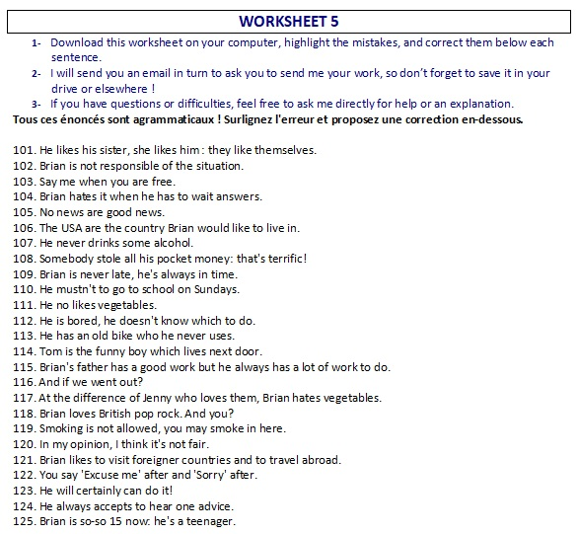

Slide 3
http://www.franglish.fr/

Slide 4
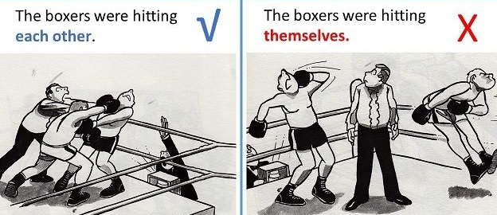
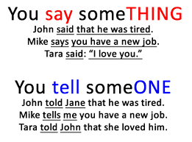
101. He likes his sister, she likes him : they like themselves.
each other (themselves = )
102. Brian is not responsible of the situation.
responsible for
103. Say me when you are free.
Tell me
104. Brian hates it when he has to wait answers.
to wait for answers
105. No news are good news.
is (a piece of news/a piece of information)

Slide 5
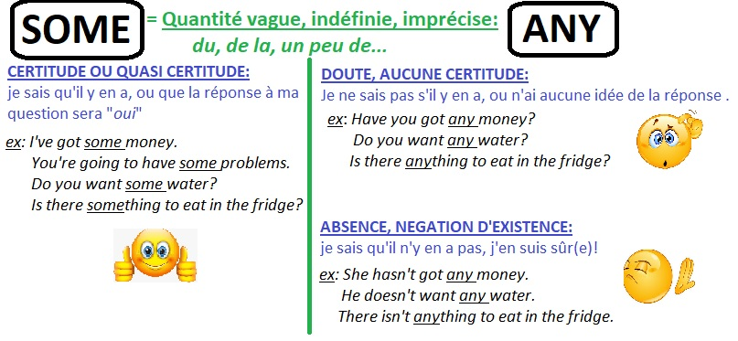
106. The USA are the country Brian would like to live in.
is (or: The USA is the country where B would like to live)
107. He never drinks some alcohol.
any
108. Somebody stole all his pocket money: that's terrific!
terrible (terrific = great and exciting)
109. Brian is never late, he's always in time.
on time

Slide 6
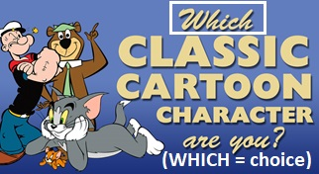
110. He mustn't to go to school on Sundays.
He doesn’t have to go
111. He no likes vegetables.
He doesn’t like
112. He is bored, he doesn't know which to do.
what
113. He has an old bike who he never uses.
which/that
114. Tom is the funny boy which lives next door.
who/that
115. Brian's father has a good work but he always has a lot of work to do.
job (A job, some work, to work)

Slide 7
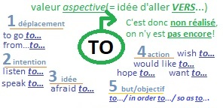
116. And if we went out?
What if (or: Let’s go out! / Why don’t we go out?)
117. At the difference of Jenny who loves them, Brian hates vegetables.
Unlike
118. Brian loves British pop rock. And you?
What about you?
119. Smoking is not allowed, you may smoke in here.
can’t
120. In my opinion, I think it's not fair.
Ø
121. Brian likes to visit foreigner countries and to travel abroad.
Brian likes visiting foreign countries and travelling abroad.

Slide 8
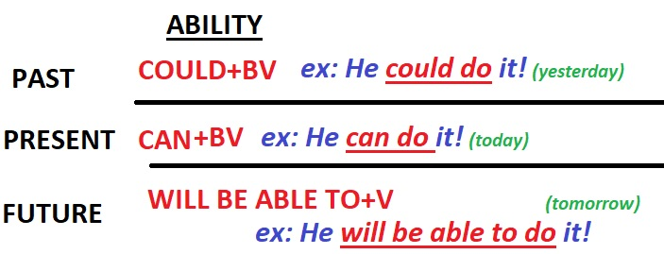
122. You say 'Excuse me' after and 'Sorry' after.
before
123. He will certainly can do it!
be able to do
124. He always accepts to hear one advice.
Ø advice/ a piece of advice/ Ø good advice
125. Brian is so-so 15 now: he's a teenager.
approximately/nearly

