Slide 1
GRAMMAR CHALLENGE
correction of WS 7
Mme Tanter, Lycée Ste Thérèse, 29000 QUIMPER, ac-rennes.

Slide 2
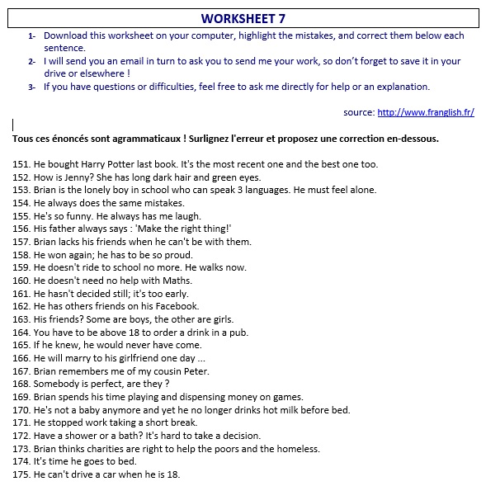
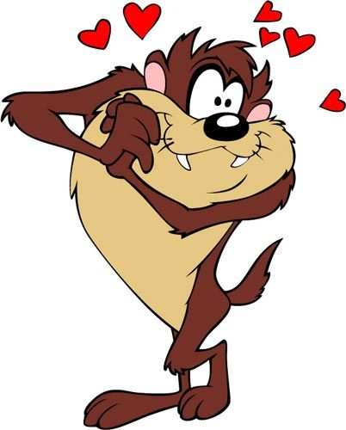

Slide 3
http://www.franglish.fr/

Slide 4
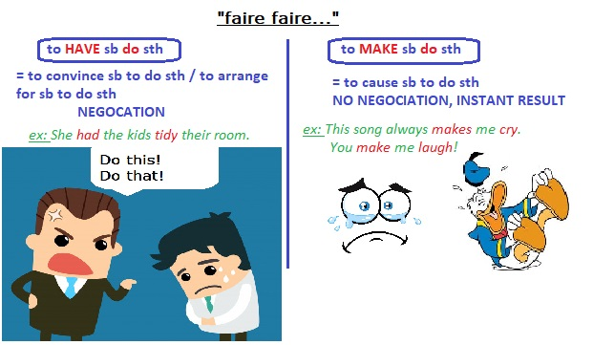
151. He bought Harry Potter last book. It's the most recent one and the best one too.
the last Harry Potter book (nb: ≠ Harry Potter’s last book)
152. How is Jenny? She has long dark hair and green eyes.
What is Jenny like? = What does she look like?
153. Brian is the lonely boy in school who can speak 3 languages. He must feel alone.
the only boy He must feel lonely (= sad feeling)
154. He always does the same mistakes.
makes ( to make a mistake)
155. He's so funny. He always has me laugh
He always makes me laugh.

Slide 5
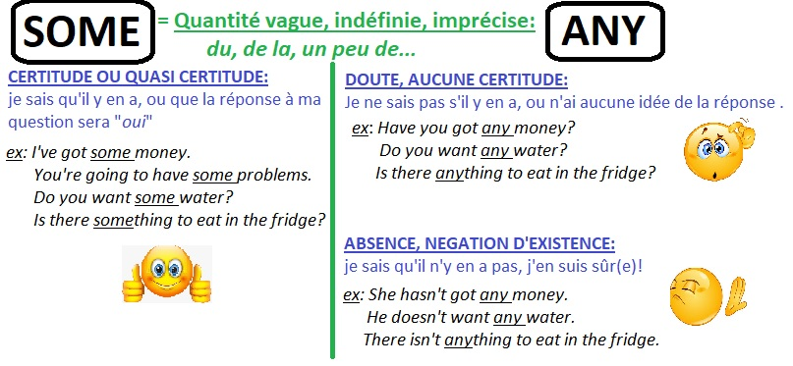
156. His father always says : 'Make the right thing!’
Do the right thing (to do sth)
157. Brian lacks his friends when he can't be with them.
misses (a lack of: absence of sth/ to miss = sad feeling)
158. He won again; he has to be so proud.
He must be (deduction)
159. He doesn't ride to school no more. He walks now.
anymore
160. He doesn't need no help with Maths.
any

Slide 6
161. He hasn't decided still; it's too early.
yet
162. He has others friends on his Facebook.
other
163. His friends? Some are boys, the other are girls.
the others
164. You have to be above 18 to order a drink in a pub.
over 18

Slide 7
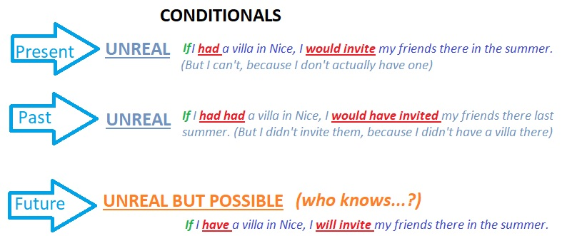
165. If he knew, he would never have come.
PRESENT: If he knew, he would never come.
PAST: If he had known, he would never have come.
FUTURE: If he knows, he will never come.

Slide 8
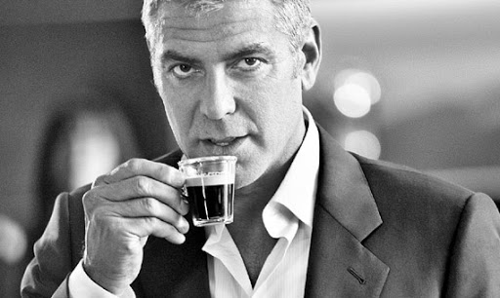
166. He will marry to his girlfriend one day ...
Ø (to marry Ø sb)
167. Brian remembers me of my cousin Peter.
reminds me of
( to remember: SE rappeler/ to remind sb of sth: rappeler qqch à qqn)
168. Somebody is perfect, are they?
Nobody
169. Brian spends his time playing and dispensing money on games.
spending (to spend money/time)
170. He's not a baby anymore and yet he no longer drinks hot milk before bed.
still

Slide 9
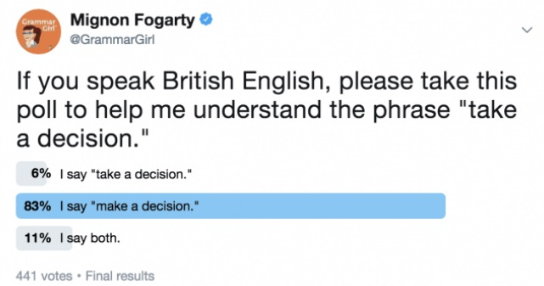
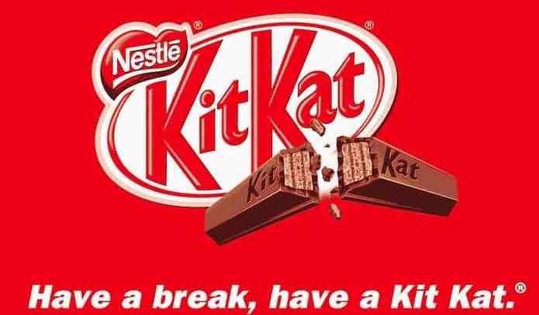
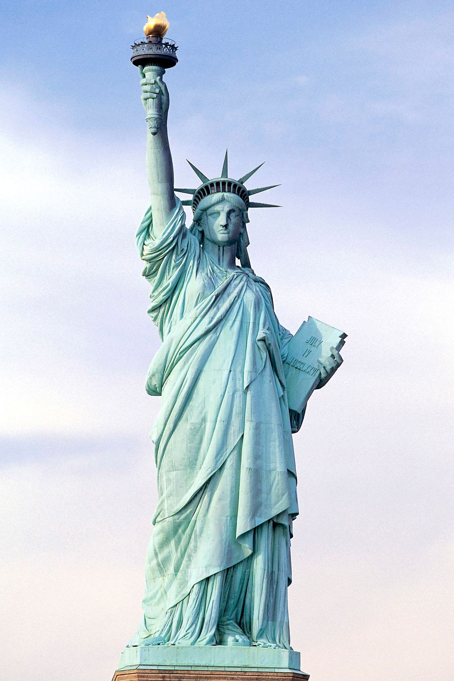
171. He stopped work taking a short break.
to have
(to have a break= have a pause )
172. Have a shower or a bath? It's hard to take a decision.
Shall I have… ? to make
173. Brian thinks charities are right to help the poors and the homeless.
the poor
Give me your tired, your poor, Your huddled masses yearning to breathe free, The wretched refuse of your teeming shore. Send these, the homeless, tempest-tost to me, I lift my lamp beside the golden door!"[
The New Colossus, 1883, Emma Lazarus

Slide 10
174. It's time he goes to bed.
went (preterit modal: valeur d’irréel present)
175. He can't drive a car when he is 18.
until he is 18/ before he is 18/ unless he is 18.

